Slide 1
ME 315 Final Project:
EFFECTs of infill Percentage ON Thermal resistance of 3d prints
1
Amelia Rinaldi
Sophia Hammarskjold
Henry Luo
Alan Medina
Daniel Berggren

Slide 2
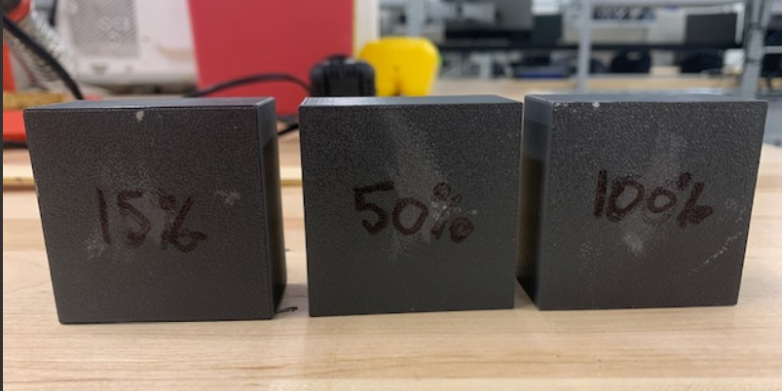
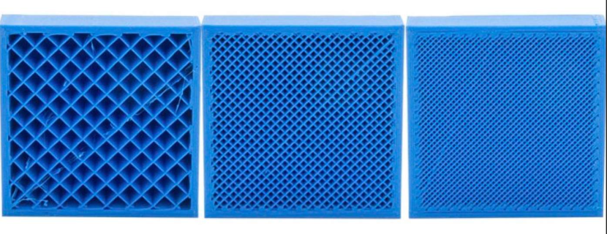
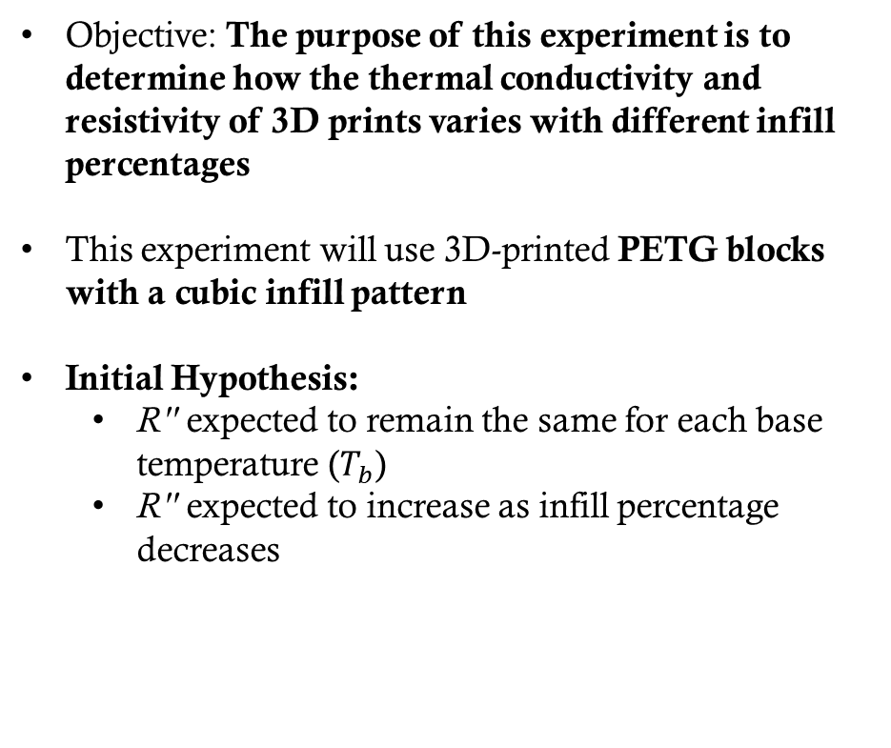
PROJECT Introduction
2
Objective: The purpose of this experiment is to determine how the thermal conductivity and resistivity of 3D prints varies with different infill percentages
This experiment will use 3D-printed PETG blocks with a cubic infill pattern
Initial Hypothesis:
  R'' expected to remain the same for each base temperature ($T_{b}$)
  R'' expected to increase as infill percentage decreases
Notes:
AMELIA

Slide 3
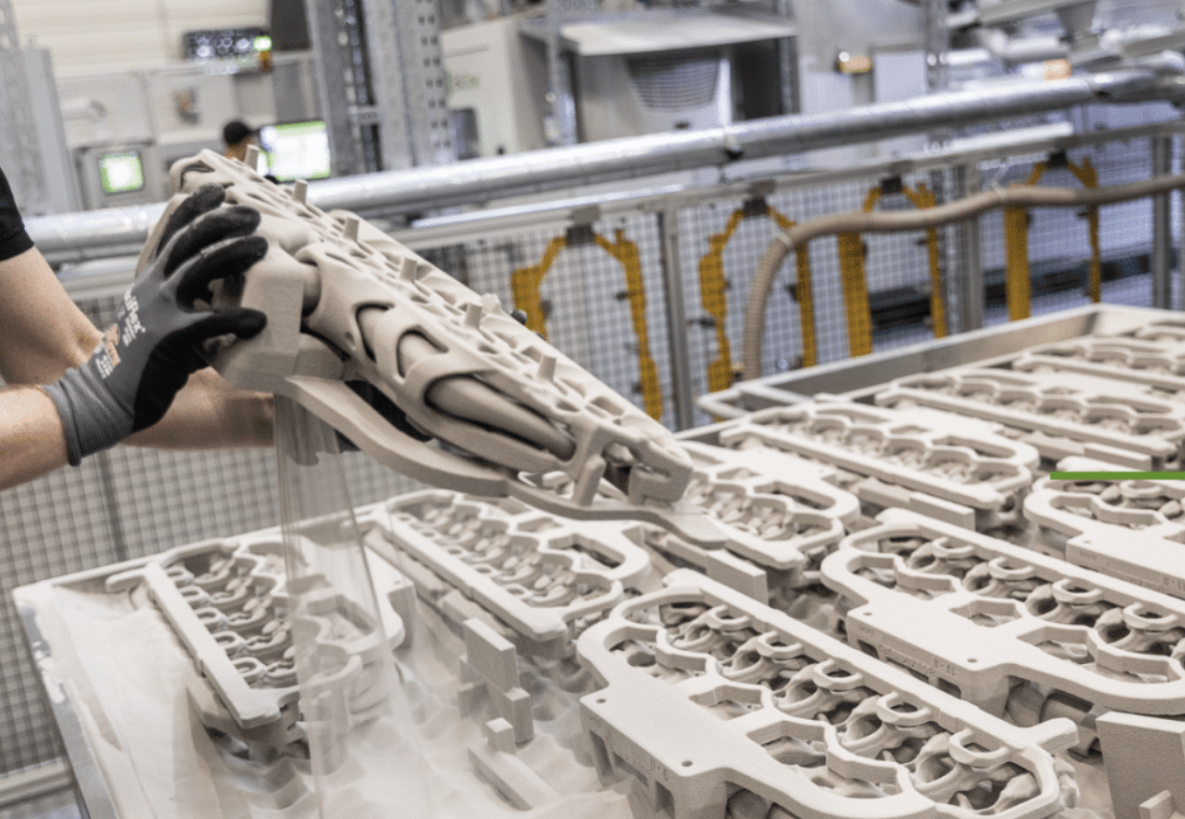
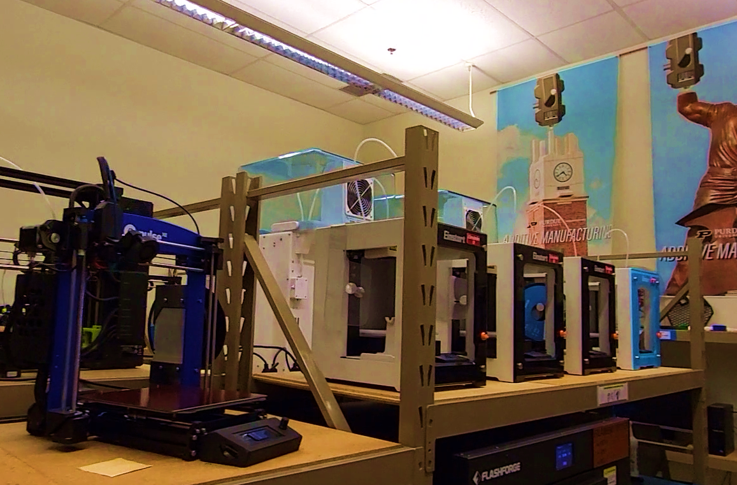
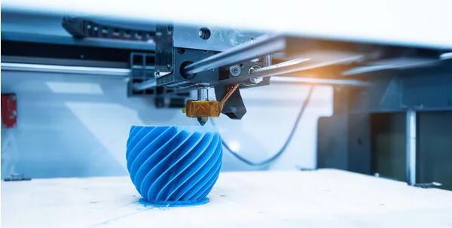
REAL WORLD APPLICATIONS
3
In the metal sand casting industry, 3D printing (BJT) of castable sands allows for complex mold geometries to be produced much more quickly than traditional methods
In rapid prototyping 3D printing allows for faster implementation of design change. This is seen at Purdue, in industry, and beyond.
Notes:
AMELIA
Rapid Prototyping
A student may consider how the infill density of their model alters some of its properties (weight, ability to drill/tap, etc.), but they may not consider how the model reacts to heating
Models may house batteries/circuitry
Lower resistance to heat transfer may allow for better cooling
BJT is binder jetting and is the primary method for printing sand molds
- Printed glue binds sand, sand supported by sand….
Infill density will effect the rigidity of the mold (at 100% infill will crack)
Infill density allows gasses to escape through pores
Ability of heat to transfer evenly through it, especially through these pores, is important in creating quality parts…

Slide 4
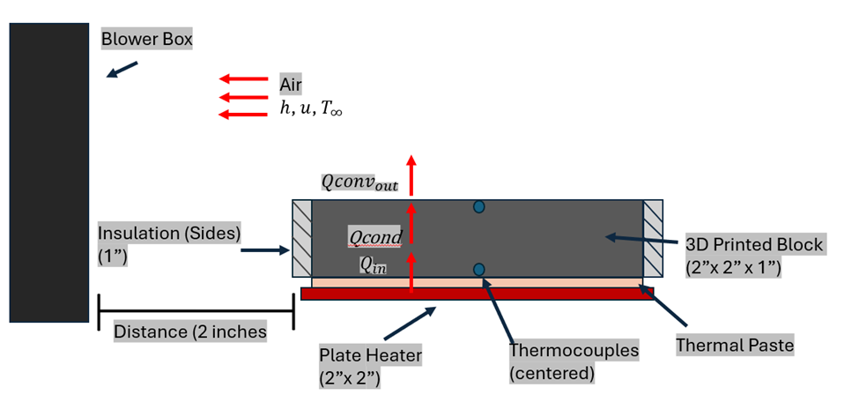
Experimental Setup
4
This experiment measures how 3D printing infill percentages changes the heat transfer behavior of a printed block exposed to forced convection
A heat patch will supply energy at the bottom of the surface. Thermocouples will be used to collect base and surface temperature data. The print will be surrounded by Styrofoam insulation. The design was chosen so that temperature behavior can be credited to the differences in infill percentages.
Notes:
ALAN

Slide 5
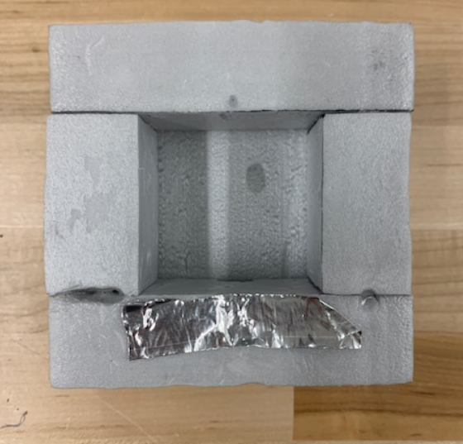
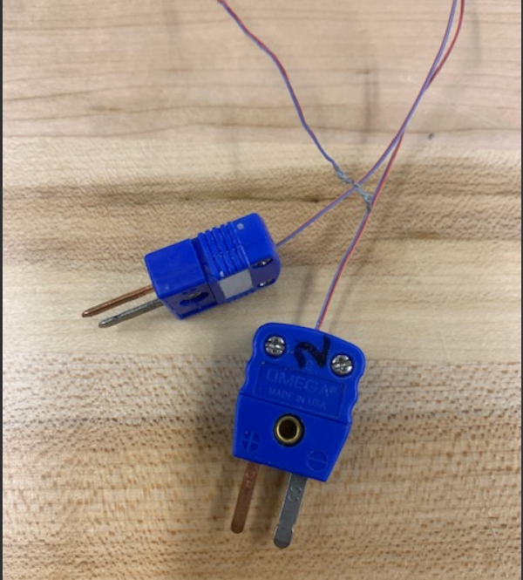
Materials
5
The following materials will be used in the experiment.
Heater (Provided)
Blower (Provided)
Thermal Paste (Provided)
Styrofoam (Provided)
Thermocouples (Provided)
Multimeter (Provided)
PETG Blocks [2” by 2” by 1”] (3D Printed)
  15%, 50%, and 100% cubic infill
Notes:
ALAN

Slide 6
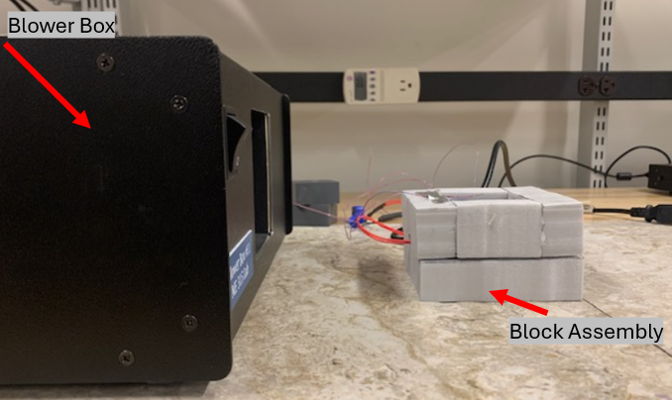
Procedure
6
Place the block on top of the heating pad inside the insulation
Place the setup against the blower box outlet
Connect heater to wattmeter and variac and record the zero-load power reading
Begin data collection, turn on the blower box and heater, and monitor the base thermocouple temperature reading
Adjust the variac to coerce the base temperature to the target temperature at steady-state
For each steady state base temperature, save the data, record the wattmeter reading, and take an IR image of block
Notes:
ALAN

Slide 7
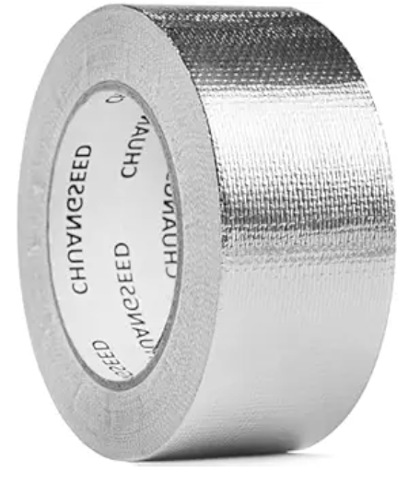
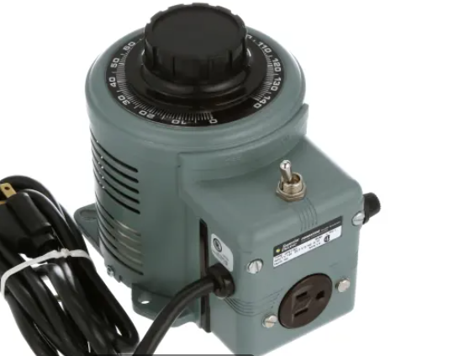
Adjustments Made To Methods
7
Removed thermal tape dependence
  Thermal tape cooled surface as it conducted heat away from the surface very efficiently, leading to inaccurate surface temperature readings
Full reliance on wattmeter reading
  Wattmeter reading produced enough precision to perform calculations with
  Variac has a lot of play, leading to inaccurate voltage readings
  No good way to measure voltage with a multimeter during runtime
Notes:
AMELIA

Slide 8
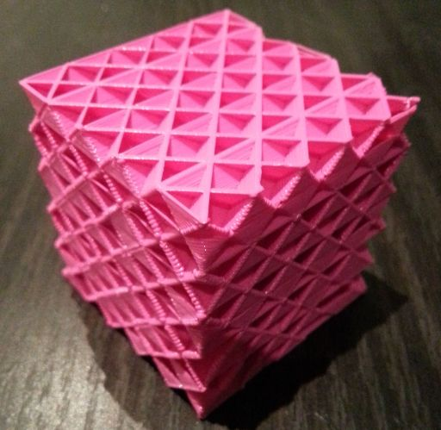
Analyses - Overview
8
Relationships to be analyzed:
Effective thermal conductivity vs base temperature for each infill percentage
  Characterize how thermal conductivity of infill varies with temperature
  Expected to be negligible
Effective thermal conductivity vs infill percentage for each target base temperature
  Characterize how thermal conductivity of infill varies with infill percentage
  Expected to be inverse
Hypothesis:
Thermal resistance (R'') is expected to remain the same for each base temperature (𝑇_{b})
Thermal resistance (R'') is expected to increase as infill percentage increases
Notes:
Daniel

Slide 9

Analyses – Assumptions and Variables
9
Assumptions:
  Steady state
  1D uniform heat flow
  Adiabatic insulation
  Even heating
  Large surroundings
  Negligible property change with temperature
  Negligible radiation
Given Quantities (Input Variables):
  Target steady-state base temperature $T_{ss}$
  Infill density $ρ_{\%infill}$
Notes:
Henry

Slide 10

Analyses – Assumptions and Variables
10
Measured Quantities (Recorded Variables):
  Ambient temperature $T_{∞}=T_{surr}$
  Base temperature $T_{b}=T\left(x=0, t=∞\right)≈T_{ss}$
  Surface temperature $T_{s}=T(x=L, t=∞)$
  Zero load electrical input power $P_{read,0}$
  Heater on electrical input power $P_{read}$
Unknown Quantities (Output Variables):
  Heat input $P_{in}$
  Block thermal resistance $R_{cond}^{′′}$
  Block equivalent thermal conductivity $k_{eq}$
Notes:
Henry

Slide 11
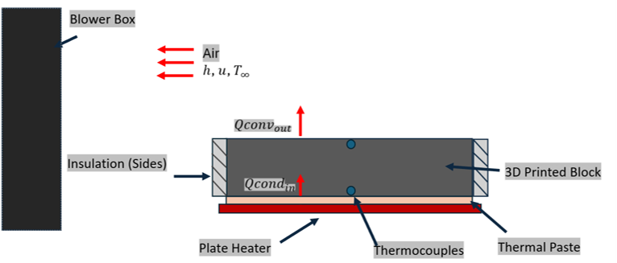
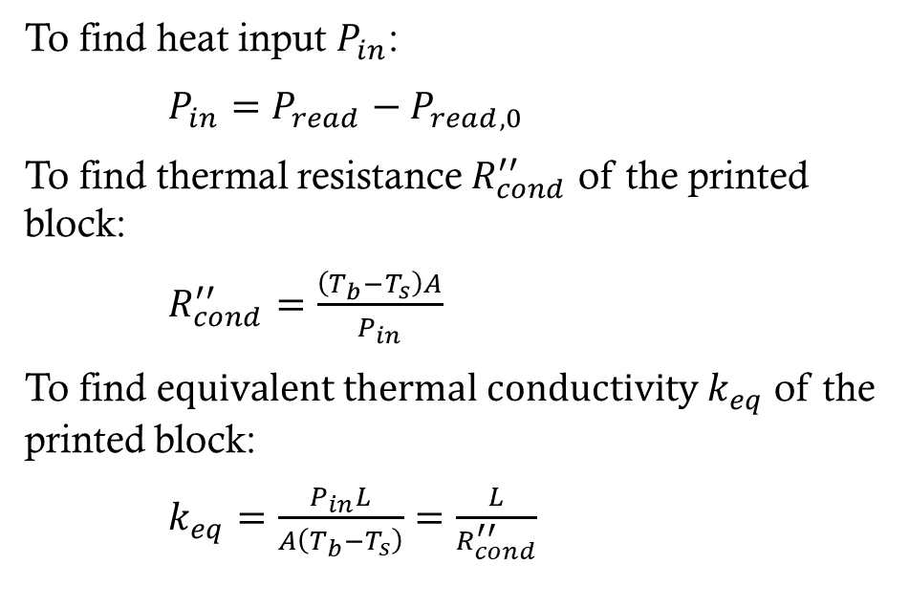
Analyses – Computation and schematic
11
To find heat input $P_{in}$:
$P_{in}=P_{read}−P_{read,0}$
To find thermal resistance $R_{cond}^{′′}$ of the printed block:
$R_{cond}^{′′}=\frac{\left(T_{b}−T_{s}\right)A}{P_{in}}$
To find e$quivalent thermal conductivity k_{eq}$ of the printed block:
$k_{eq}=\frac{P_{in}L}{A\left(T_{b}−T_{s}\right)}=\frac{L}{R_{cond}^{′′}}$
Notes:
Henry

Slide 12

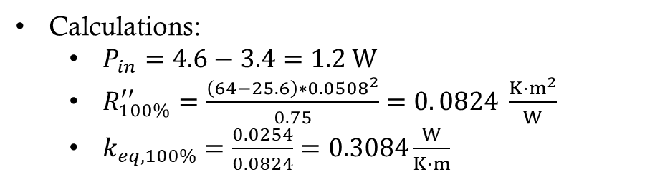
Experimental Calculations
12
For 100% Infill PETG @ Target Base Temperature 64°C:
  $L=W=2 in=0.0508 m$
  $H=1 in=0.0254 m$
Experimental Measurements:
  $T_{b}={64}^{∘}C=T_{ss}$
  $T_{s}={25.7}^{∘}C$
  $q_{read}=4.6 W$
  $q_{read,0}=3.4 W$
Calculations:
  $P_{in}=4.6−3.4=1.2 W$
  $R_{100\%}^{′′}=\frac{\left(64−25.6\right)∗{0.0508}^{2}}{0.75}=0. 0824 \frac{{K⋅m}^{2}}{W}$
  $k_{eq,100\%}=\frac{0.0254}{0.0824}=0.3084\frac{W}{K⋅m}$
Notes:
HENRY

Slide 13
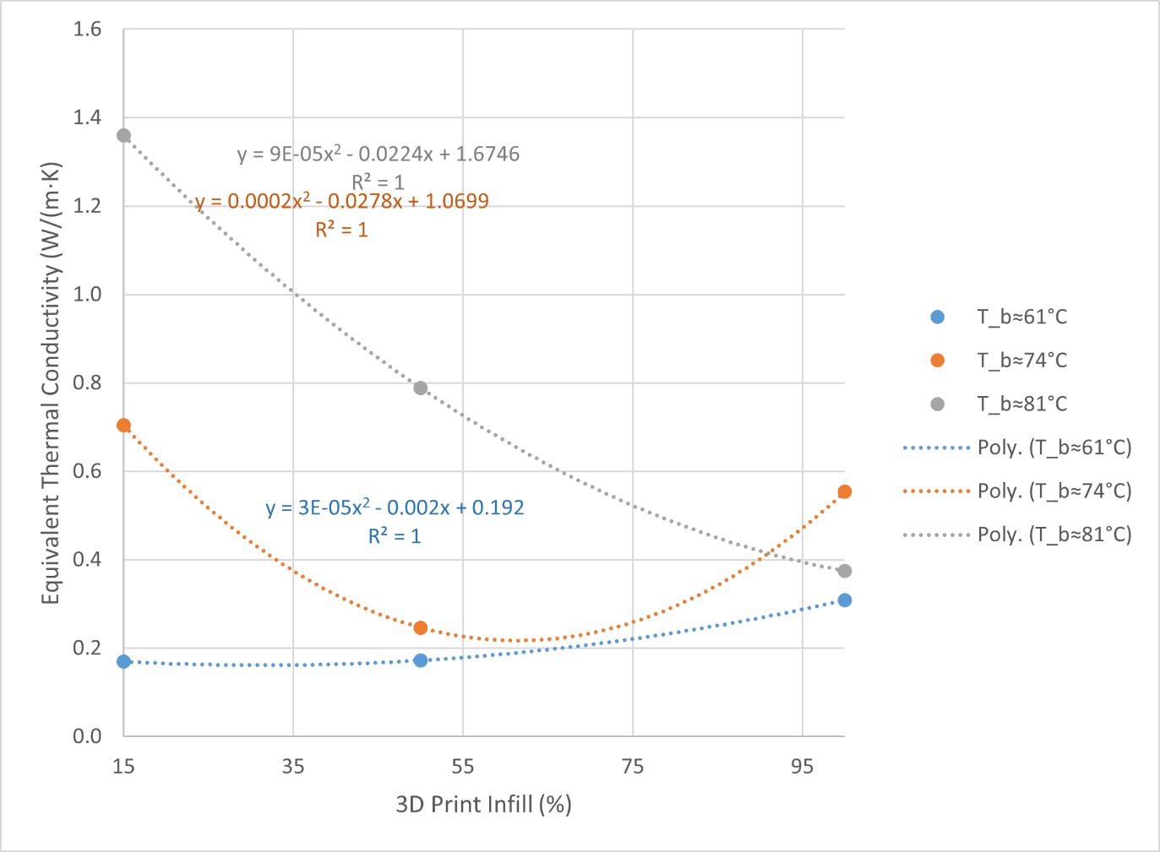
Experimental Results
13
The slope of each temperature increases significantly above the glass transition temperature of ~75 C
Data at low temperature matches expected results.
Notes:
DANIEL

Slide 14
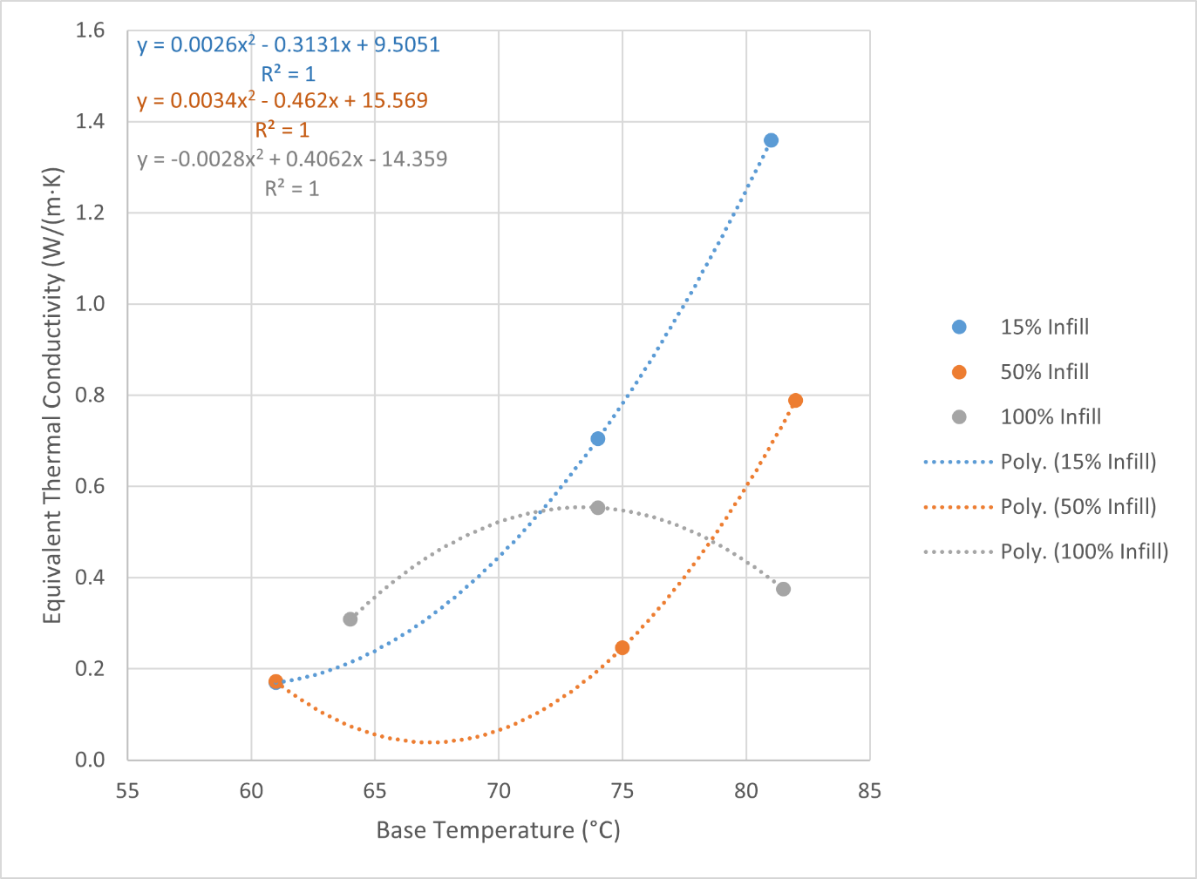
Experimental Results
14
The slope of each infill increases with base temperature
100% infill exhibits the opposite trend.
Our hypothesis dictates that the thermal conductivity should be relatively constant and increase with infill.
Results can be explained due to convection effects and glass transition.
Notes:
DANIEL

Slide 15
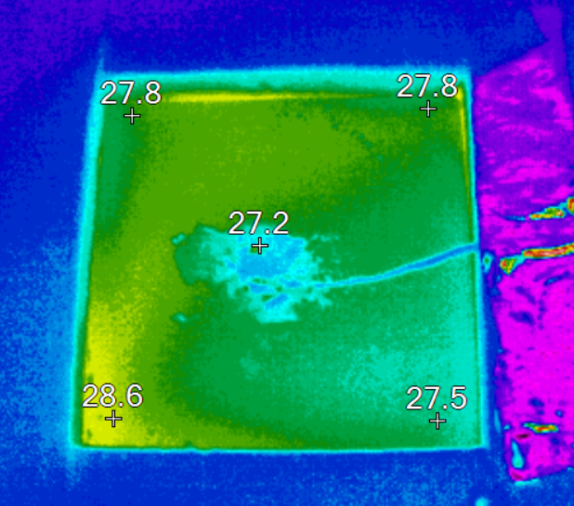
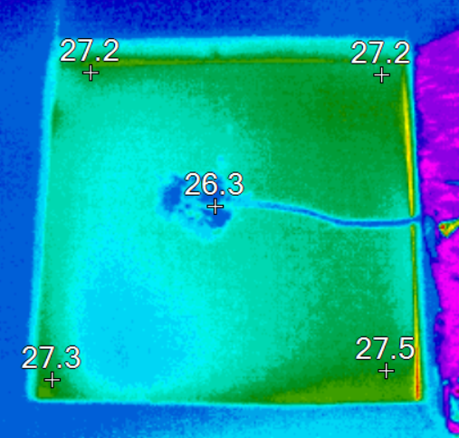
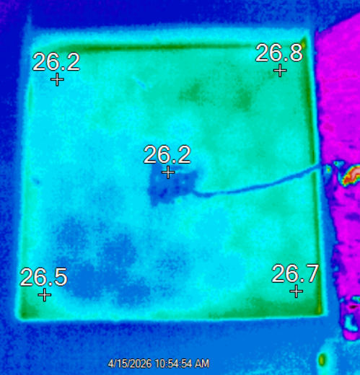
Thermal Images
Thermal imaging of 100%, 50%, and 15% (left to right) infill at a base temperature of ~72 degrees..
Notes:
daniel

Slide 16
potential Sources of error
16
Thermocouple error/noise
  Was mitigated by thermocouple testing and calibration
Nonuniform heat input
  Can be improved by using better equipment which can regulate wattage input
Imperfect insulation
  Can be improved by creating a more perfect fit and filling gaps between cuts
Print defects
  Can be improved by using higher quality filament and printers
Notes:
Sophia

Slide 17
Conclusion
17
Generally, thermal conductivity values increased with base temperature
Underestimated the effect of pores Thermal conductivity varied the most at lower infill percentages, highlighting the relevance of convection within the pores
Several factors contributed to error and noise within the data, especially related to the equipment
Notes:
Sophia

Slide 18
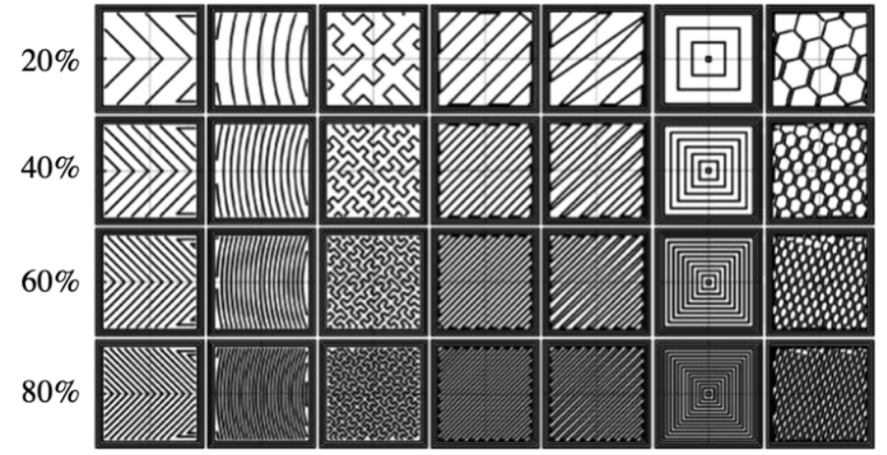
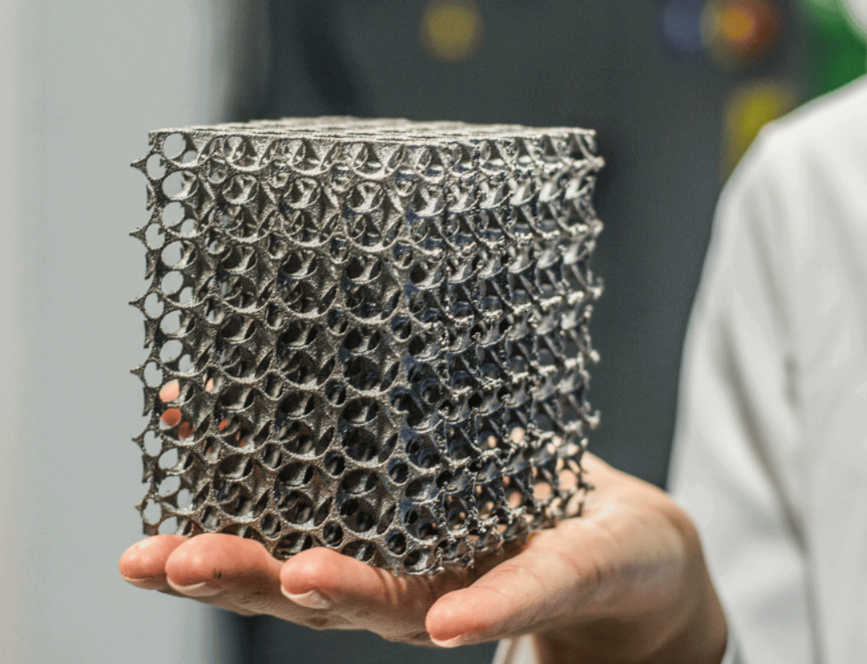
Future Experimentation
Different infill types could be studied in addition to just infill densities
  100% infill density is generally not used in additive manufacturing applications)
Different materials could be tested, especially metals, as the testing process would be faster due to higher thermal conductivity values
  Also avoids glass transition temperature related issues
Better equipment should be used which can better regulate power input to improve the accuracy of the data and reduce noise
Notes:
Sophia

Slide 19
Thank you!
19

